Slide 1








Slide 2
Minds in Context

Slide 3

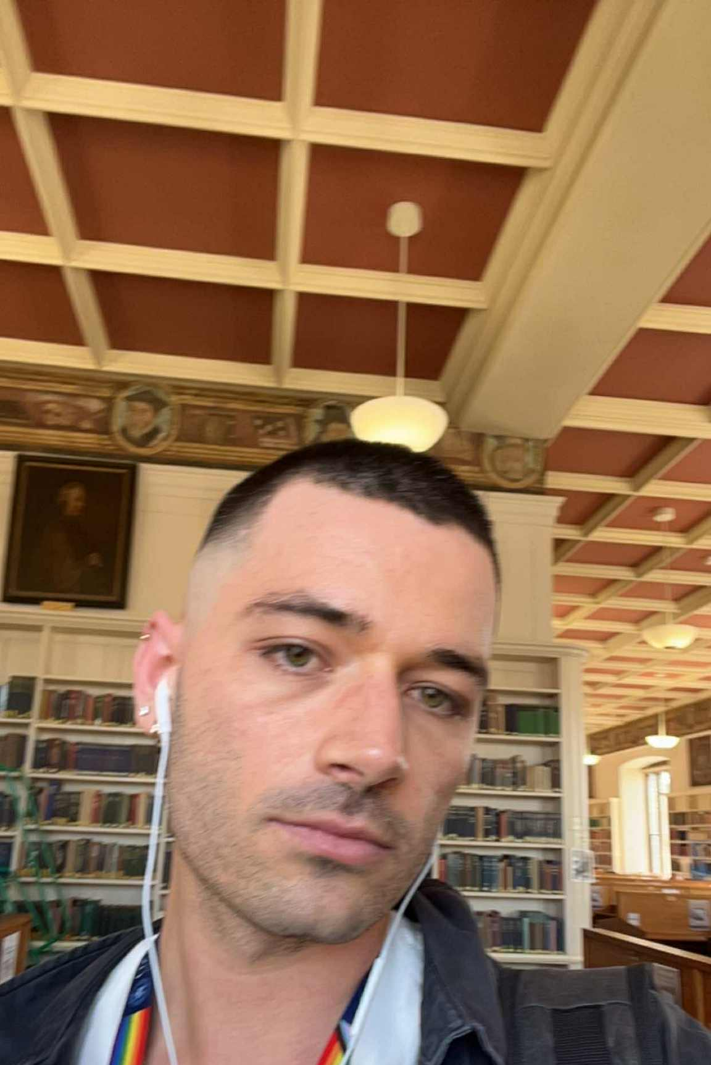
16. August 19.30
Ilagata 2, 0171, Oslo, Norge

